Slide 1


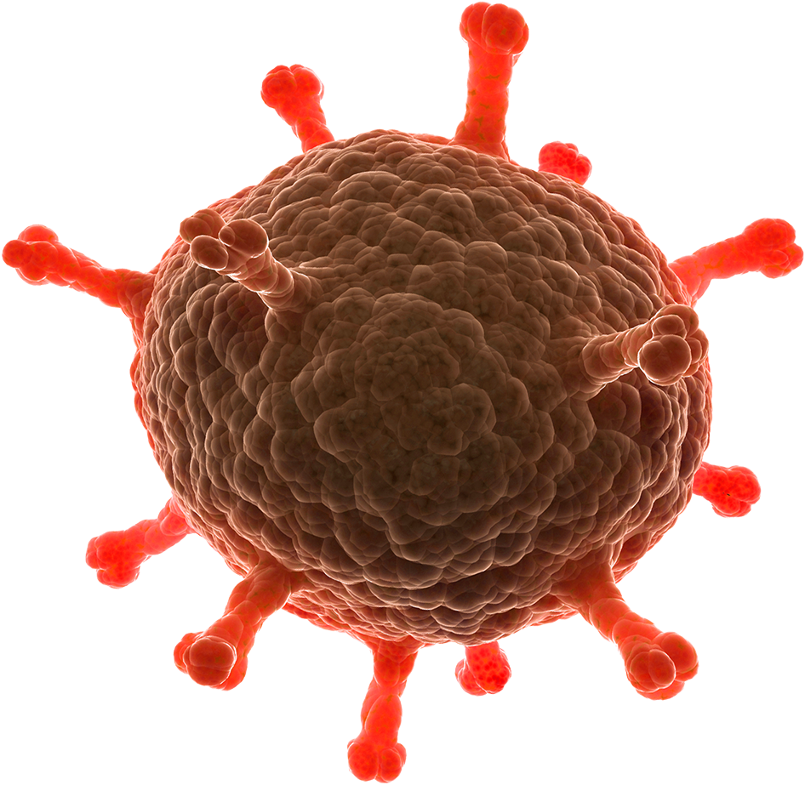



Disease detector bot
Health is wealth and don’t try to play with both health and wealth

Slide 2
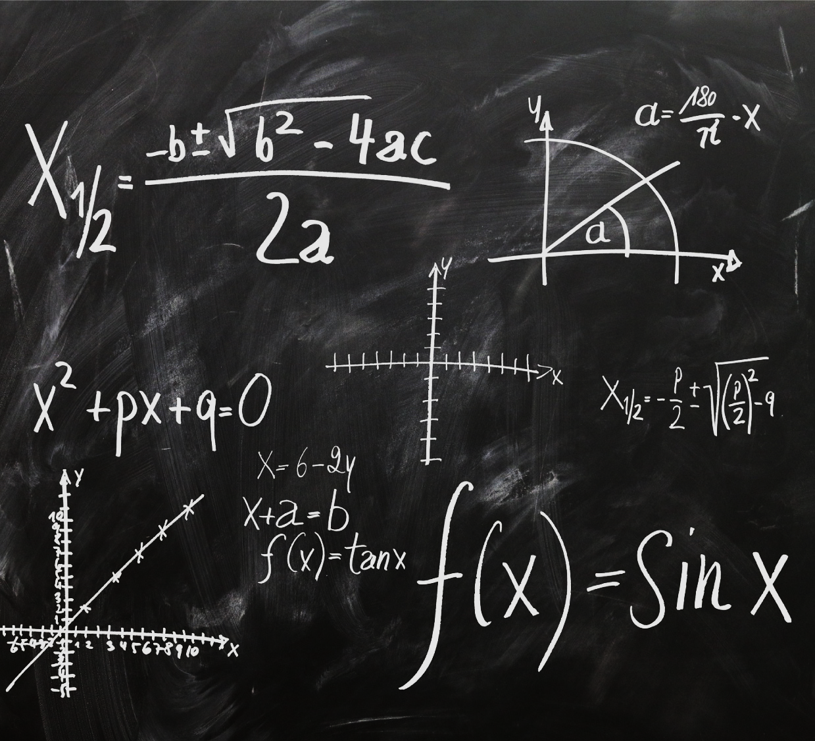

About
A Chatbot developed entirely using Python which helps in detecting the Disease of the Person using the answers given by the users to the according to the questions put-forth.

Slide 3

Team Name: metadata Done BY
Name: Sriniketh J, Athish M, Subhiksha E
College: PSG Institute of Technology and Applied Research
Department: Electronics and Communication Engineering
Year of Study: II – Year
E-Mail Address: srinikethcr7@gmail.com (primary)
Phone Number: 6385685916 (primary)

Slide 4


timeline
A timeline of the actions leading to the Development of the Bot
Dataset Gathering
Data Preprocessing
ML-Model (Decision Tree) - Train & Building
Bot Making and asking Questions
Display the Disease name and recommendation to overcome it

Slide 5
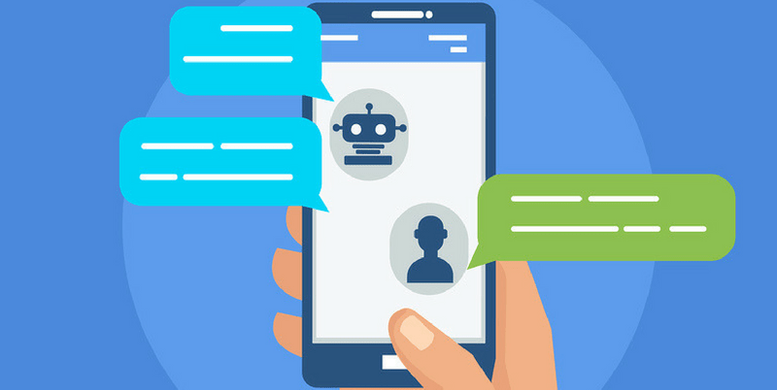
working
The bot is very interactive one.
It will ask different question each and every time and is not repetitive.
It will change the queries and number of queries each and every-time.
Number of query change will depend on the user’s input.
Uses decision tree algorithm to generate output.
It displays the disease present, symptoms present, symptoms given (if required) and confidence level (if required).

Slide 6


Advantages
Easy to understand
Very interactive
Simple Questions
No hesitation as it happens while going to visit doctors
Disease Identification
Leads to correct diagnosis or reach doctors

Slide 7
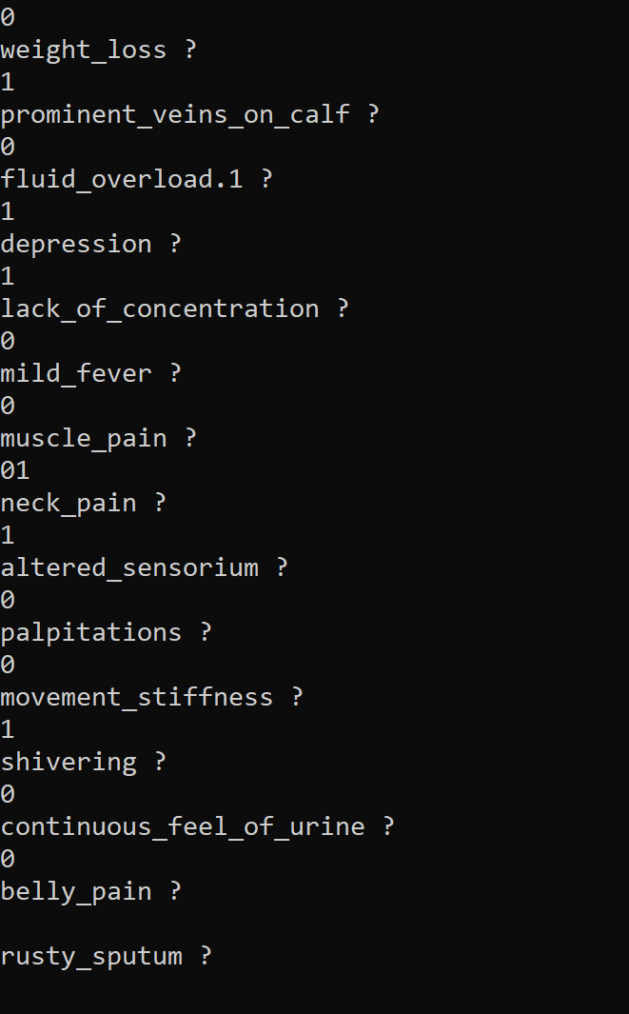
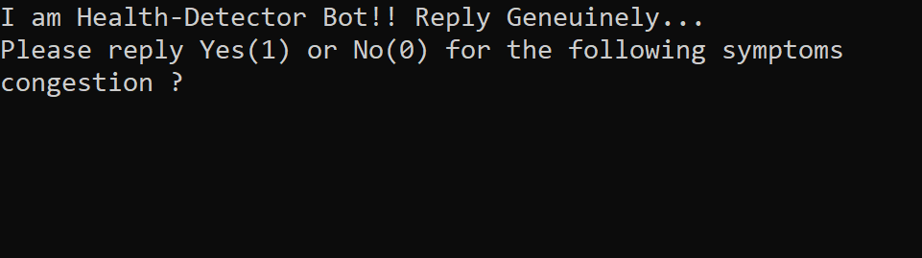
Screenshots

Slide 8

GitHub: https://github.com/srini047/IgniteHacks Presentation Deck: https://drive.google.com/drive/folders/1QYb1s-ag3etPXdVRfIZzSAKUwGYukNO8?usp=sharing YOUTUBE: https://youtu.be/xnAbiXPl09s
Important Links

Slide 9

Egnite - ideathon
For providing us the opportunity to Pitch our Idea and Prototype.
Hope to see that our Idea get’s selected and receives Prizes.
🤞🤞🤞🙏🙏🙏😊😊😊
Happy Hacking!!

